Slide 1


TRAINUAL
TRAINING MANAGEMENT SYSTEM
Trainer:
Syed Nawas Ahamed
Team Members :
Sasikumar S
Vikash R
Bharath G
Jeevananth J
Saravanan J

Slide 2

Content
Introduction
Purpose
Objectives
Use case Diagram
Modules
Flow Diagram
Conclusion

Slide 3
Introduction
Training management system is specifically developed for trainees for accessing the assessment through online and view the assessment scores.
Training activities that learners are undertaking are aligned with duties, roles and responsibilities.
Training delivery is effective and efficient – i.e., only includes activities that add value, uses the most cost effective technologies and maximizes the use of personnel and resources.
Training management systems are used by training companies and learning and development departments to streamline training operations.
These solutions help users to design, organize, scale, and maintain training programs. training management systems often provide solutions for all learning professionals (including training companies and learning and development departments) that schedule, track, and assess training efforts while overseeing employee training progress.

Slide 4
Purpose
To make the training management process accessible anywhere to the employee.
To allow the trainee to update their profile and view the assessment , upload the answer script and assessment scores.
To allow the admin to efficiently manage their database and maintains the relationship in an effective manner.
To maintain data consistency and integrity.

Slide 5
Objectives
The project “Trainual” is aimed to develop to maintain the day-to-day activities , view the HR, trainer manager, trainer and trainee.
To computerize all details regarding HR, trainer manager, trainer , trainee details.
Schedule the assessment for trainee and view the assessment by HR , trainer manager and trainer.

Slide 6
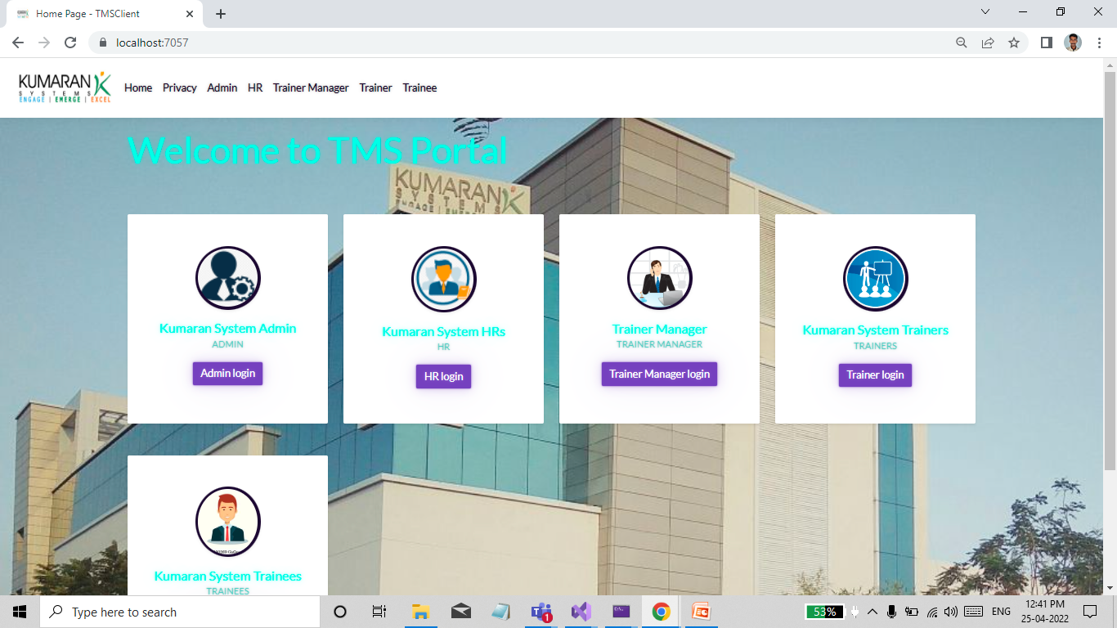
Home Page

Slide 7
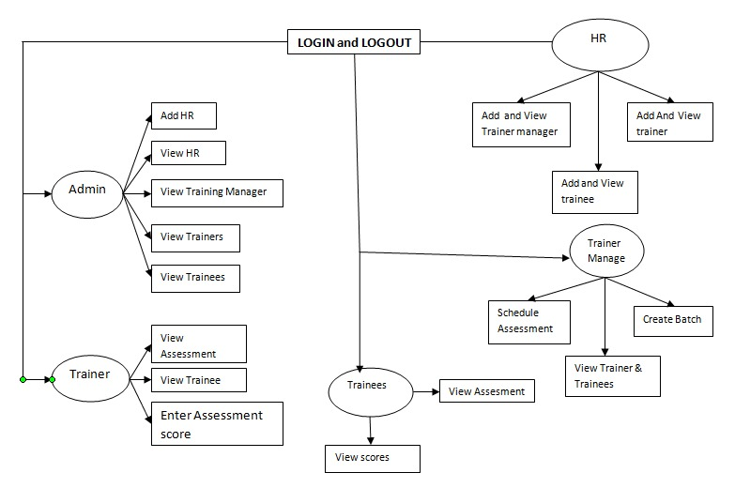
Use Case Diagram

Slide 8
Admin Module
In this module the admin will be able login by entering ‘login id’ and ‘password’.
The ‘login id’ and ‘password’ will be inbuilt for admin.
The admin after logged in will be directed to a new page. in that page admin was create
A new HR, trainer and trainee using there details.
Admin was provide a ‘login id' and ‘password’ to a new HR.
They can use the login id and password to login.

Slide 9
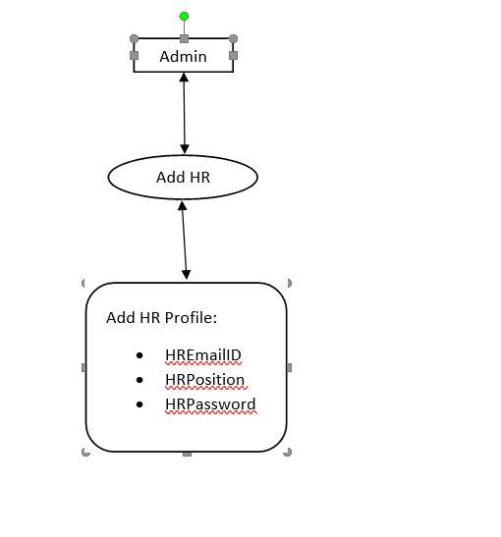
Flow Diagram

Slide 10
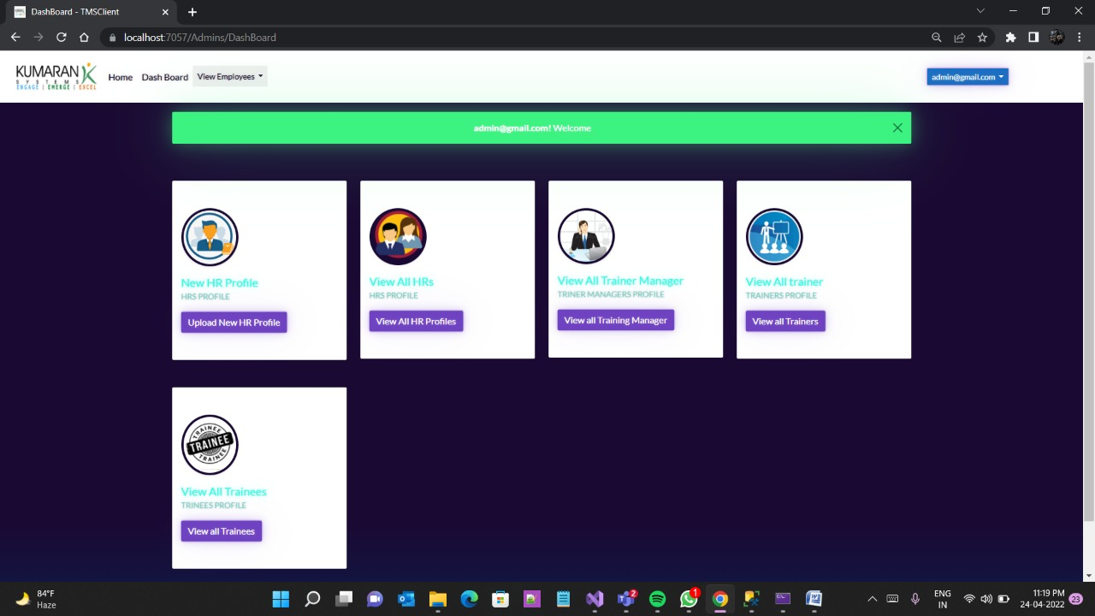

Slide 11
HR Module
HR gets login with the username and password given by the admin.
They can update their profile using the update profile button where the details are updated along with their password.
They can add new trainer which has attributes like email id, position and password.
They can add new trainer manager which has attributes like email id, position and password.
They can add new trainee which has attributes like email id, position and password.
Whenever a trainer manager is added, they can view the trainer and trainee profiles.
Whenever a trainer manager is assign a assessment. they can view the assessment.

Slide 12
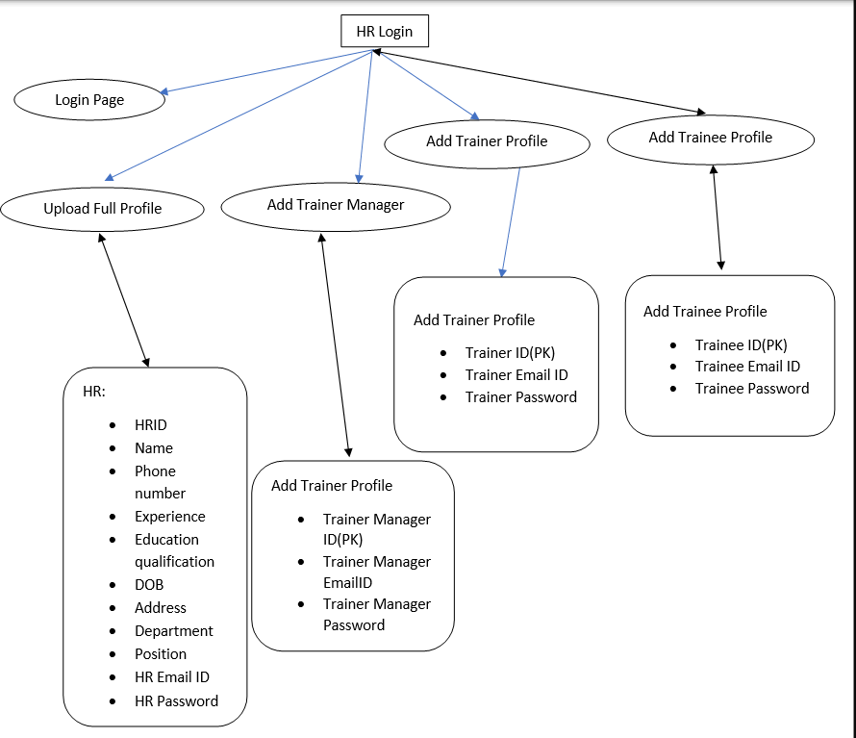
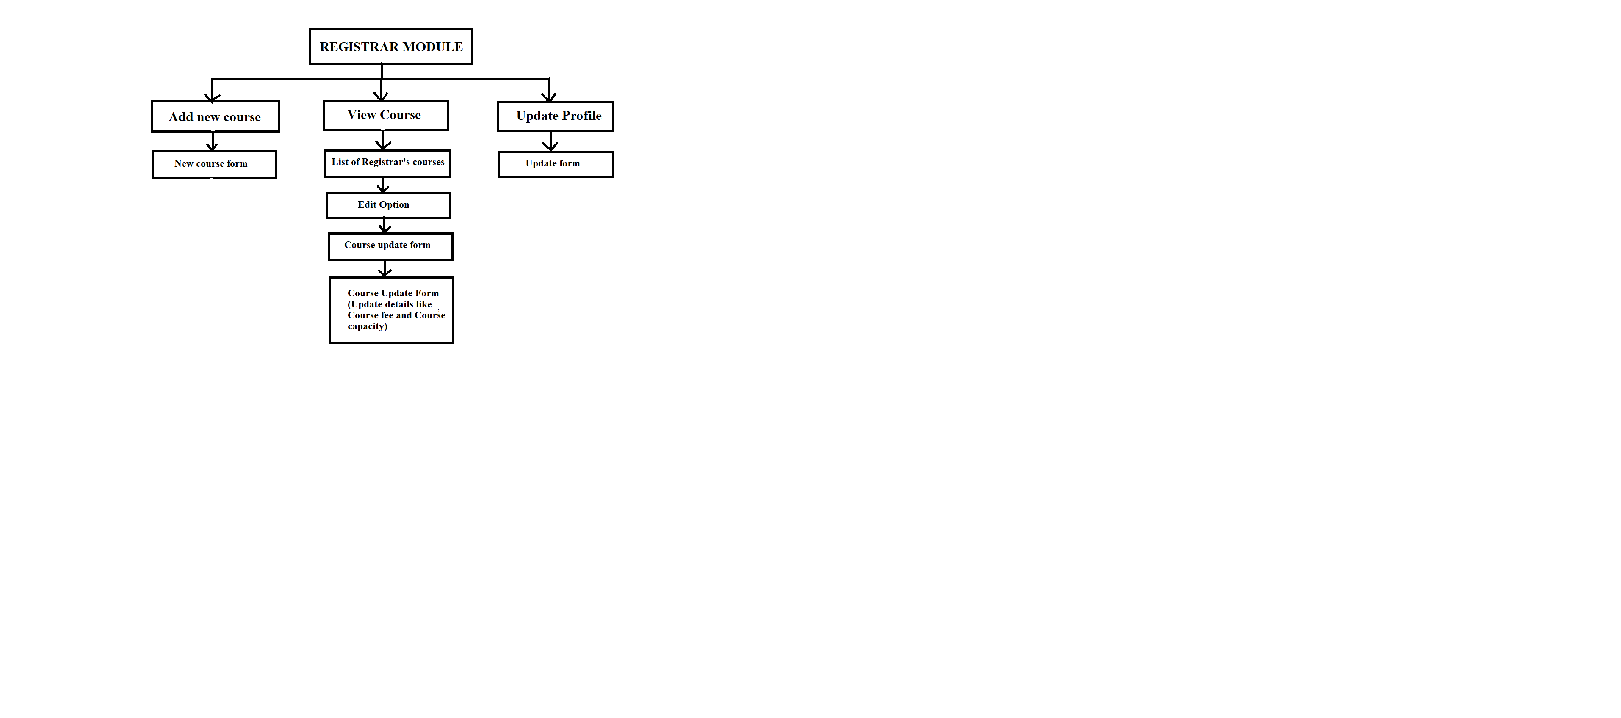
Flow Diagram

Slide 13
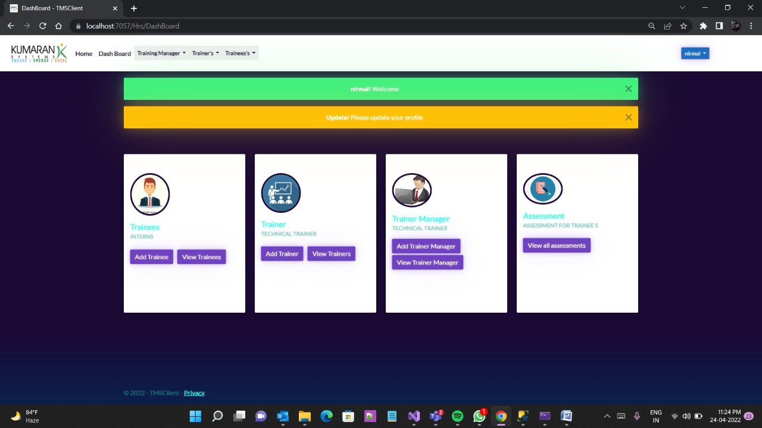

Slide 14
Trainer manager Module
Trainer Manager gets login with the username and password given by the HR.
They can update their profile after they can login.
They can view the trainer and trainee profile.
They can create a new batch and map the trainee to this trainer and also they can view the batch.
They can schedule the assessment date with their batch. because that particular batch students only access this assessment and also they can view the assessment.

Slide 15
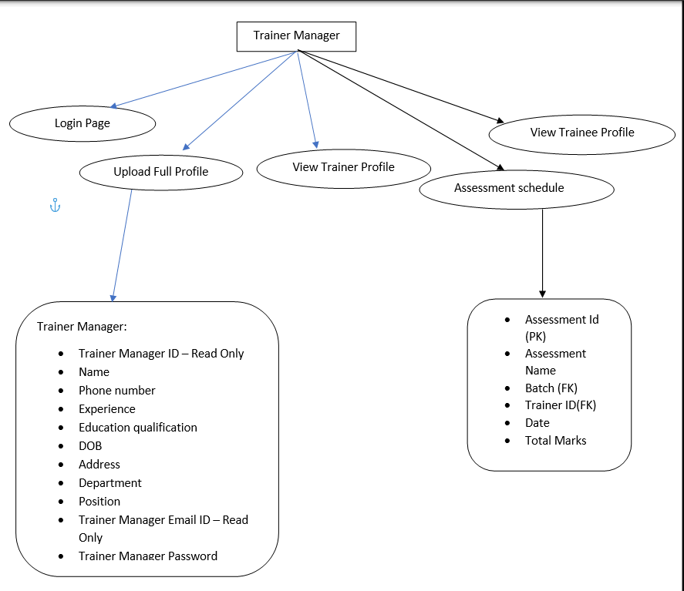
Flow Diagram

Slide 16
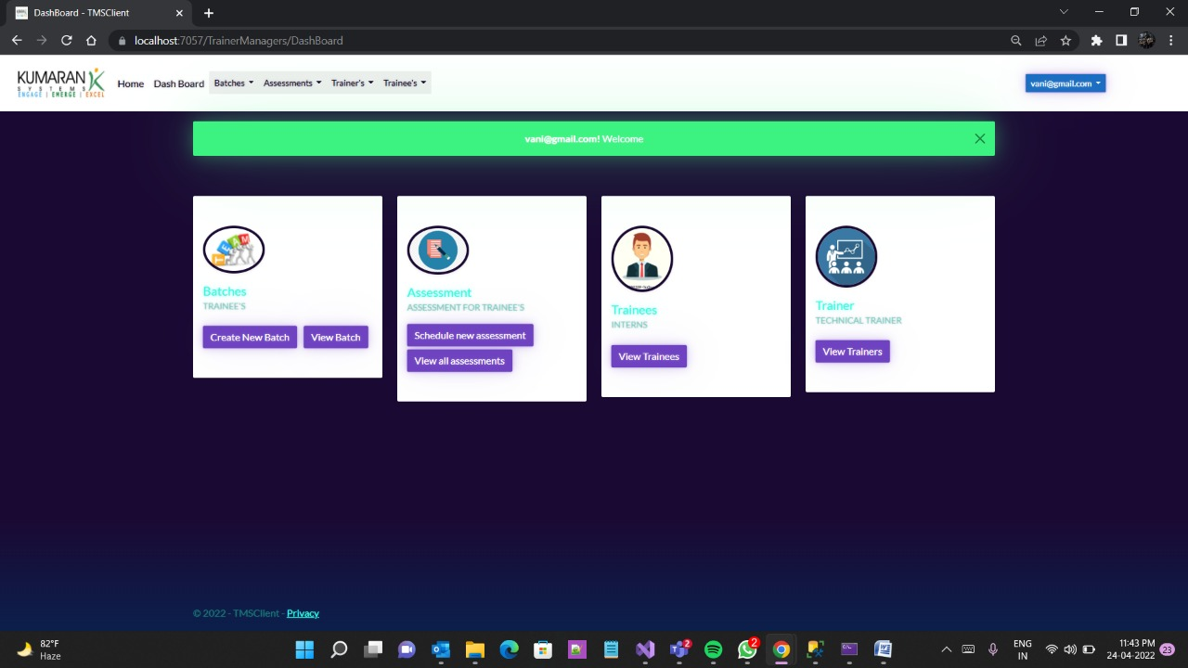

Slide 17
Trainer Module
Trainer gets login with the username and password given by the HR.
They can update their profile after they can login.
They can view the trainee profile.
They can view the assessment after Training manager schedule the assessment and Trainer can upload the Assessment Question Paper.
Trainer can view the Assessment and they give the Score for that Assessment.

Slide 18
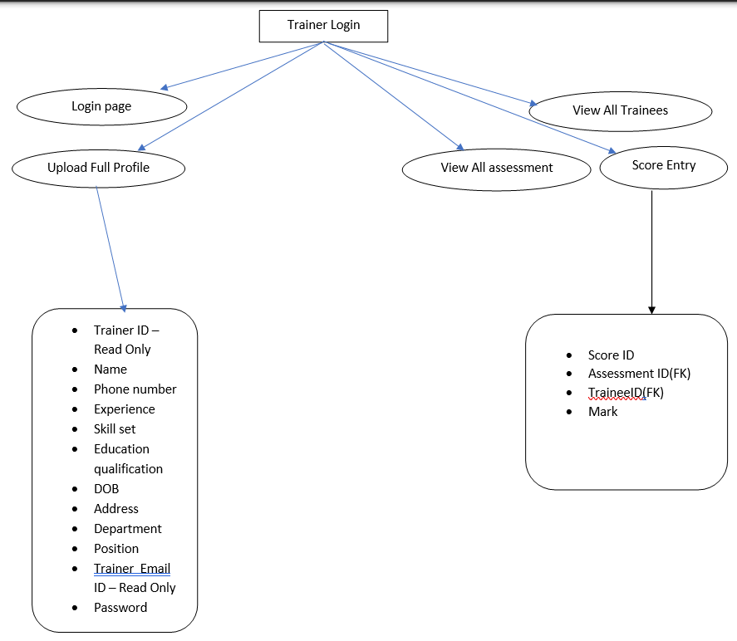
Flow Diagram

Slide 19
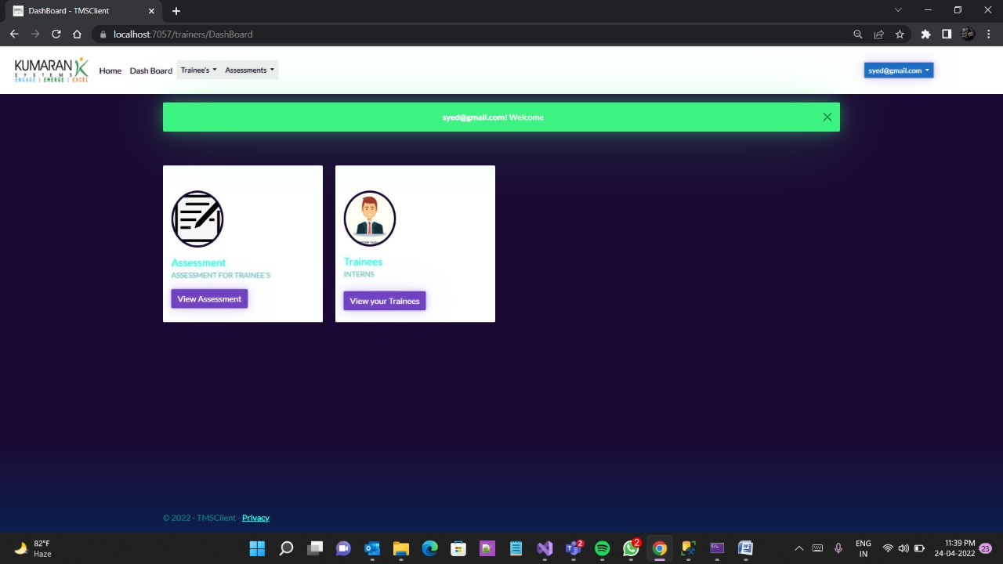

Slide 20
Trainee Module
Trainee gets login with the username and password given by the HR.
They can update their profile after they can login.
They can View the Assessment after Training manager schedule the assessment and Trainer can Upload the Assessment Question Paper.
After complete the Assessment Trainee can Upload the Answer Script.
Trainer can view the Assessment and They can Give the Scores for Assessment. After Trainer give the Assessment Score, Trainee can view the Scores of Assessment.

Slide 21
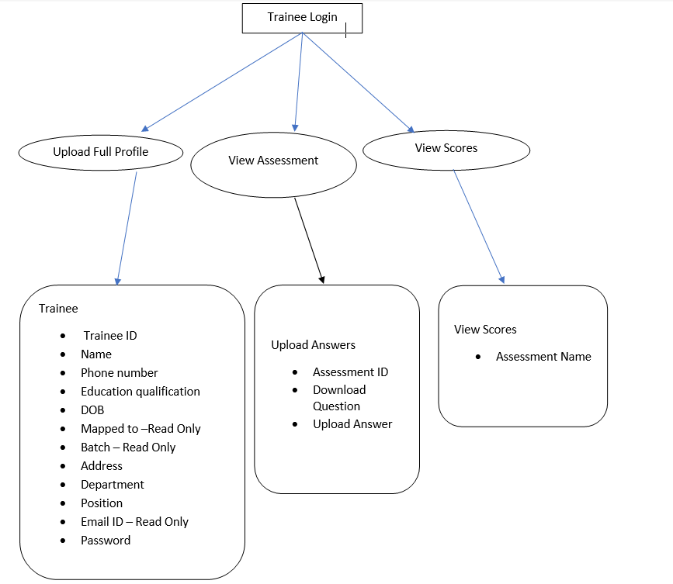
Flow diagram

Slide 22
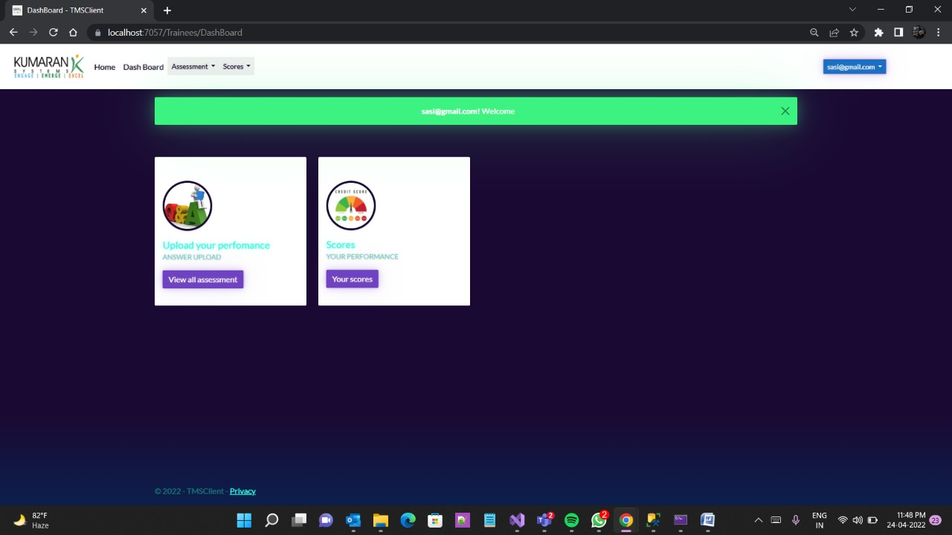

Slide 23
Conclusion
Our application’s main goal is providing online training portal for the trainee where they can view the assessment, upload answer script and view the scores for assessment after trainer was give the scores.
It is complete in the sense that it is operational and it is tested by entering data and achieving the requirements.
But there is always a scope for improvement and enhancement according to our client’s need. we hope to achieve them and make our application even more productive.

Slide 24
Thank you

